Slide 1
FOOD SURVEY PRESENTATON

Slide 2
INDEX
INTRODUCTION
PROBLEM STATEMENT
VISUAL REPRESENTATIONS
CONCLUSION

Slide 3
PROBLEM STATEMENT
Problem Statement is finding the most frequent food which is being eaten by the people during this COVID-19 pandemic.

Slide 4
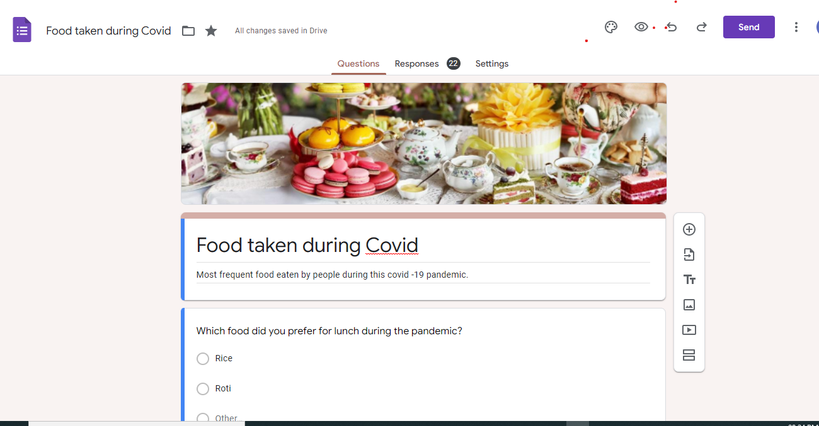
QUESTIONS

Slide 5
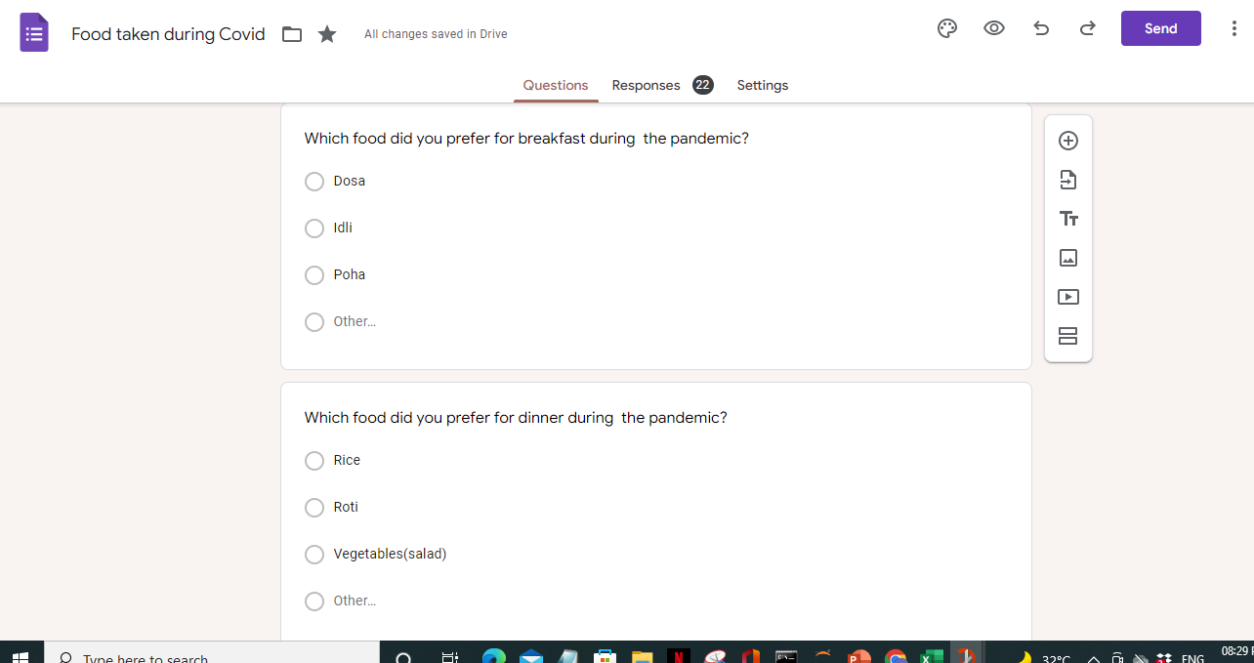

Slide 6
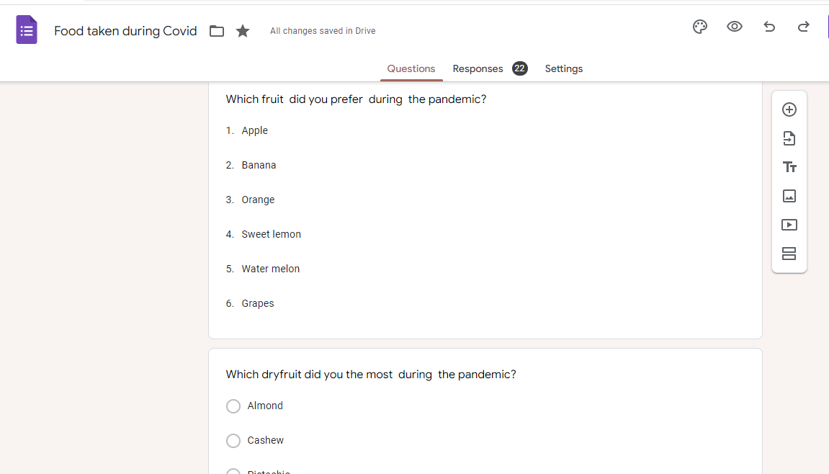

Slide 7
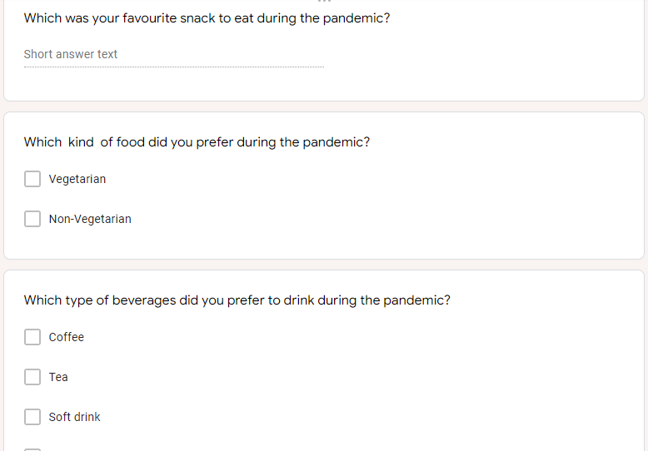
Add a Slide Title - 2

Slide 8
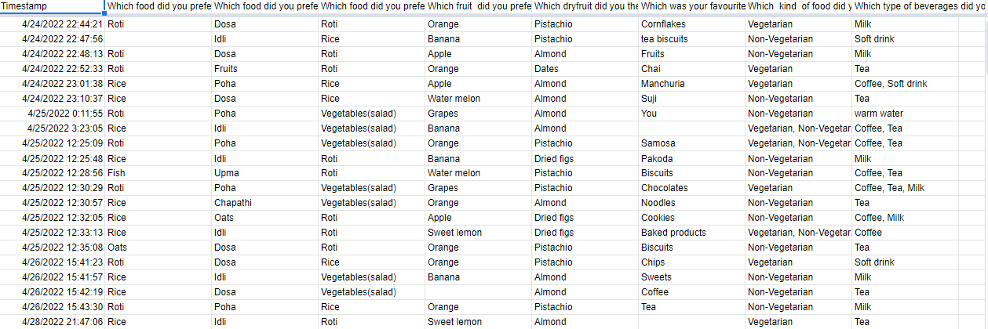
RESPONSES

Slide 9
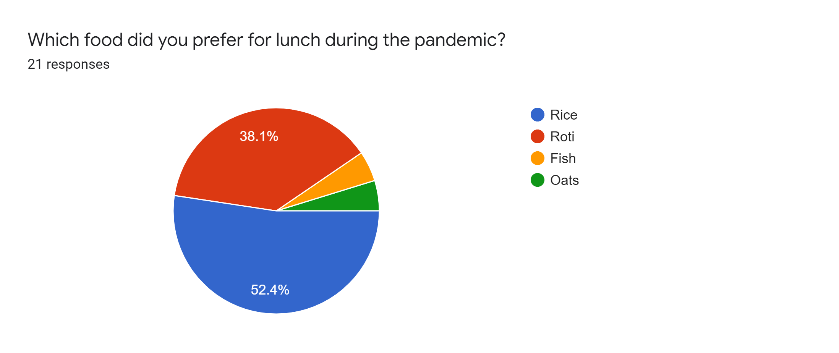
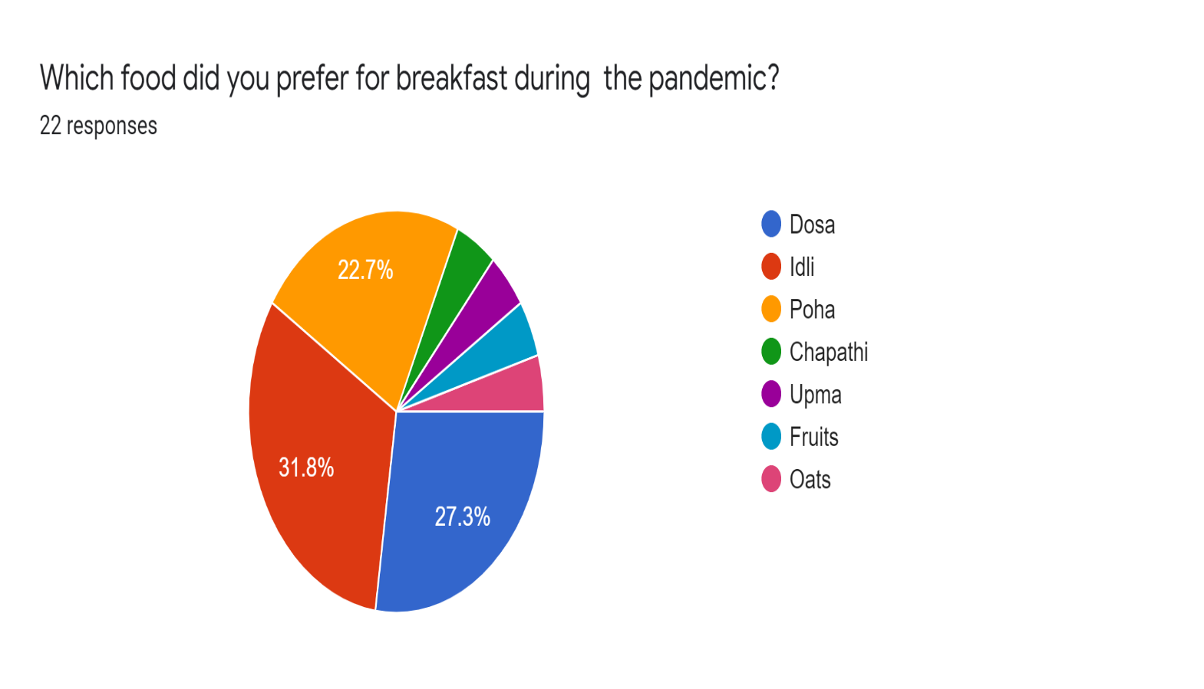

Slide 10
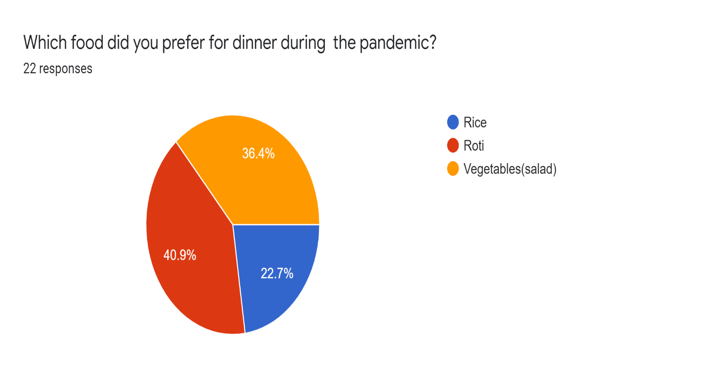
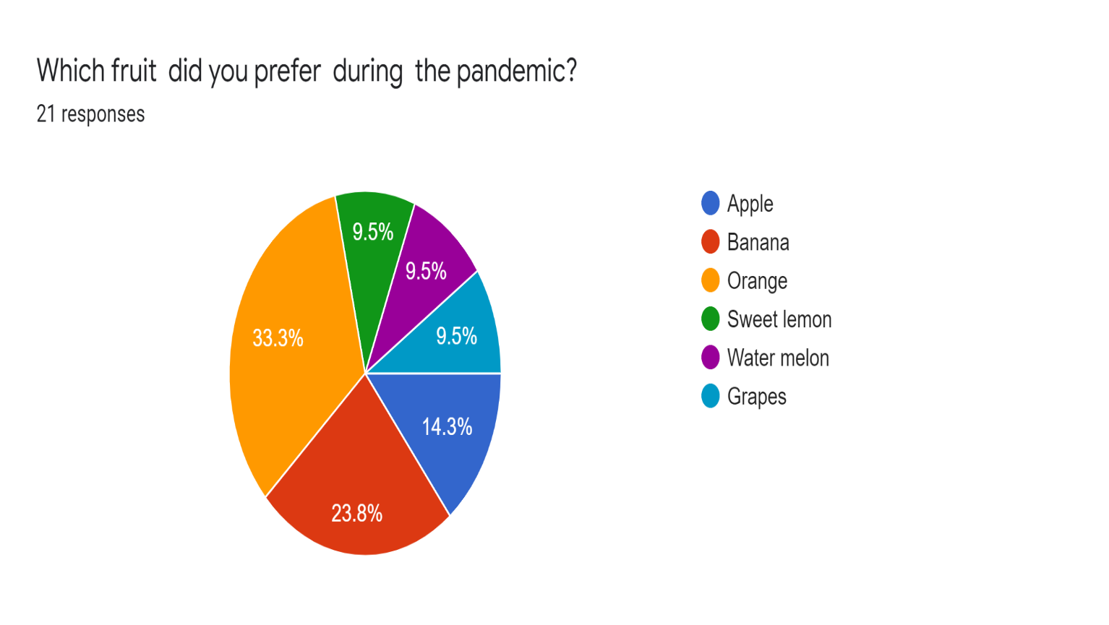
Add a Slide Title - 4

Slide 11
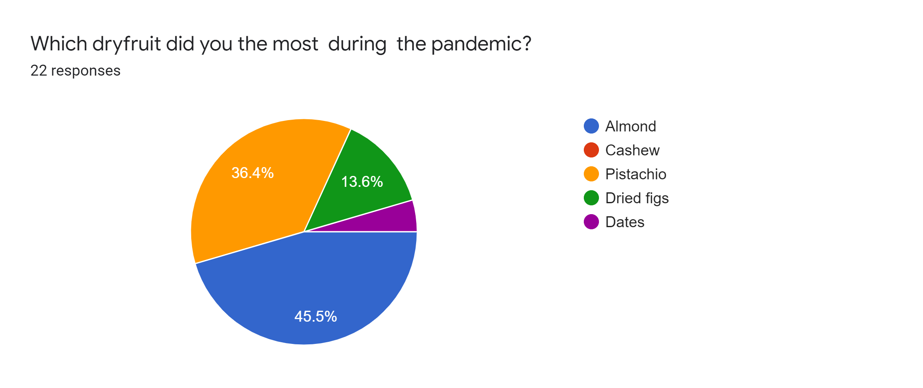
Add a Slide Title - 5

Slide 12
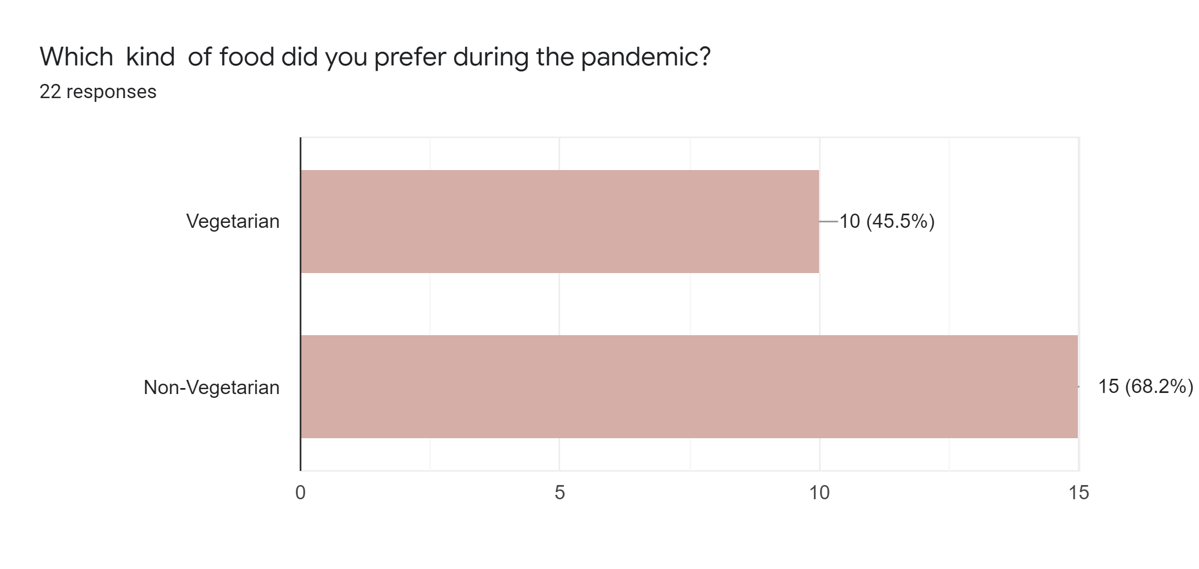

Slide 13
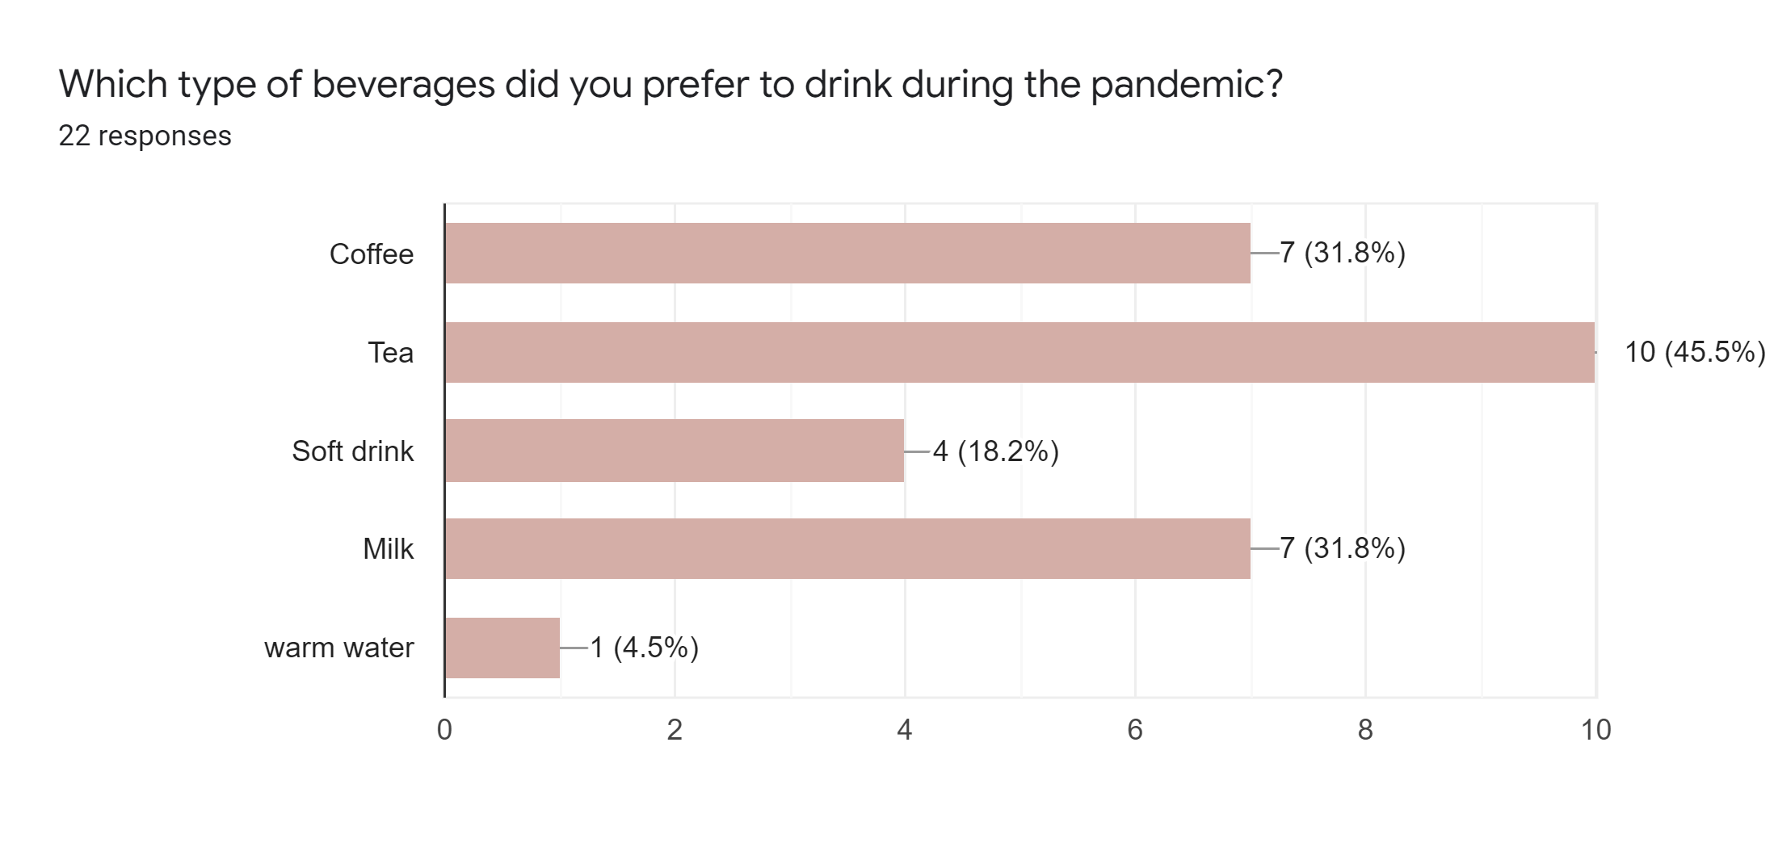

Slide 14
THANK YOU _PALADI JAHNAVI

